Slide 1

created by Marco, Harald, Rene, Phillip and Leonie

Slide 2
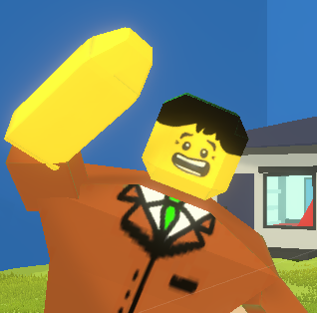
Table of contents
Story
Game Mechanics
Gameplay
Website

Slide 3
Table of contents
Story
Game Mechanics
Gameplay
Website

Slide 4
Table of contents
Story
Game Mechanics
Gameplay
Website

Slide 5
Table of contents
Story
Game Mechanics
Gameplay
Website

Slide 6
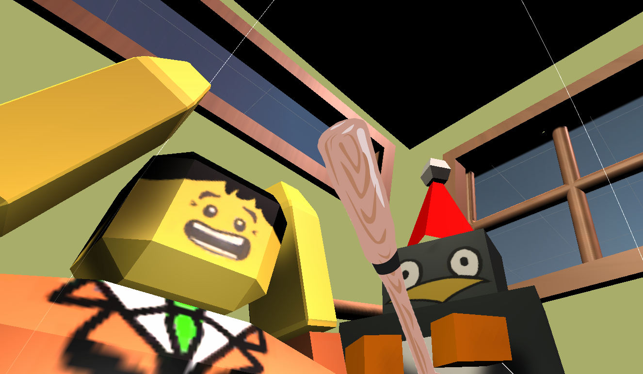

Slide 7
Olaf

Slide 8
Brian

Slide 9
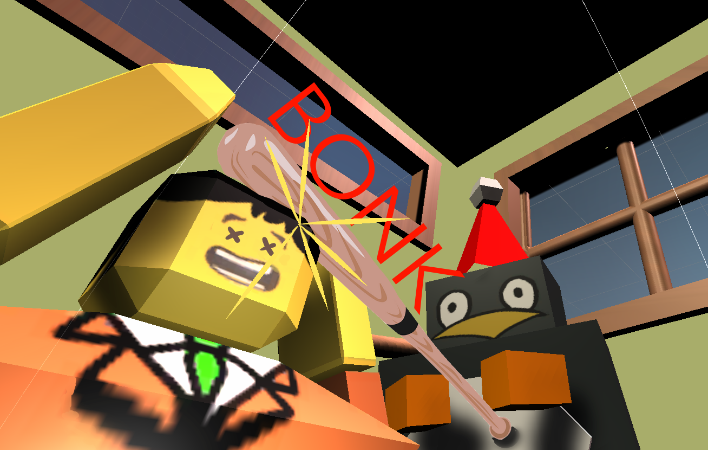

Slide 10
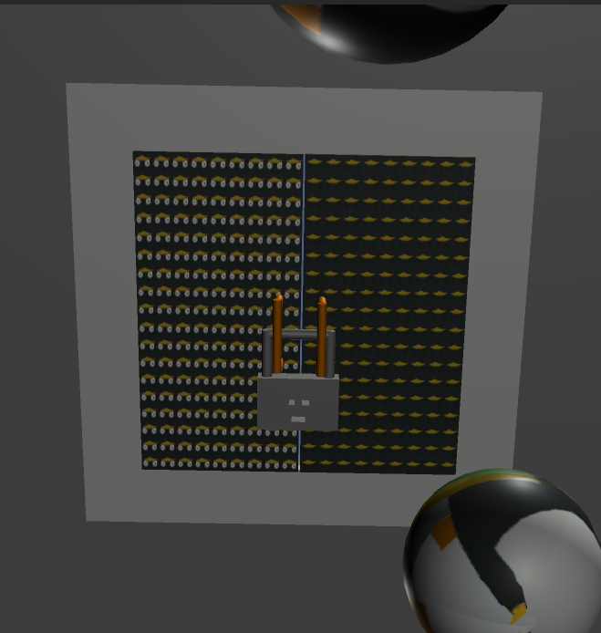

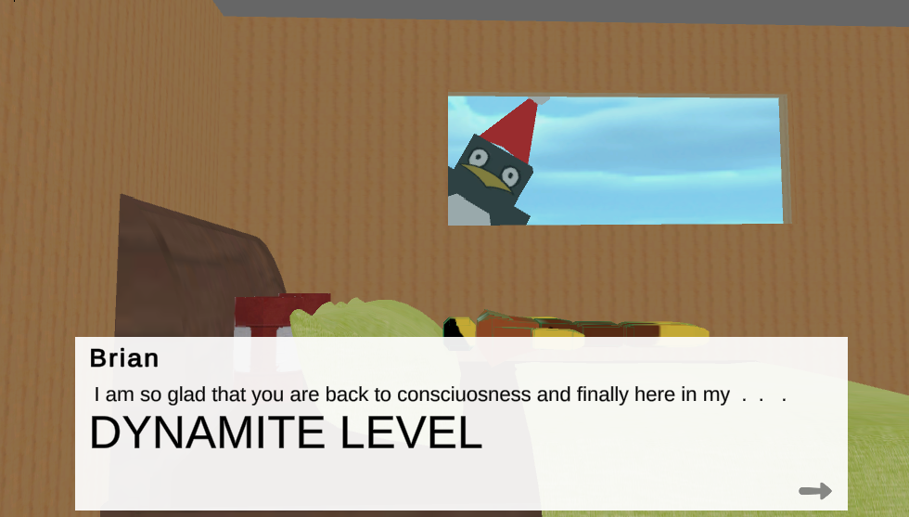
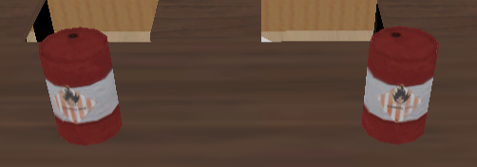
Level features

Slide 11

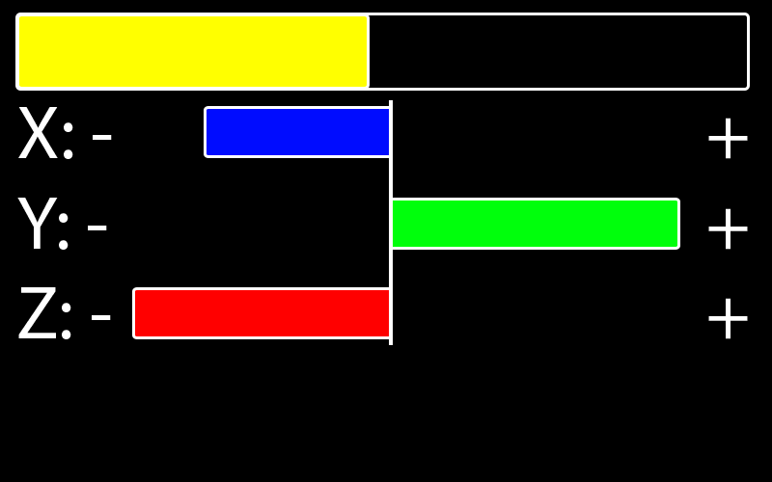
Gravity control

Slide 12
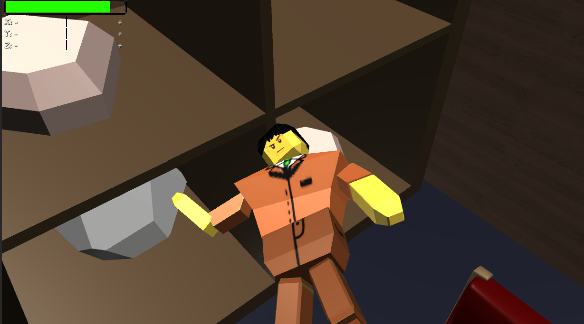
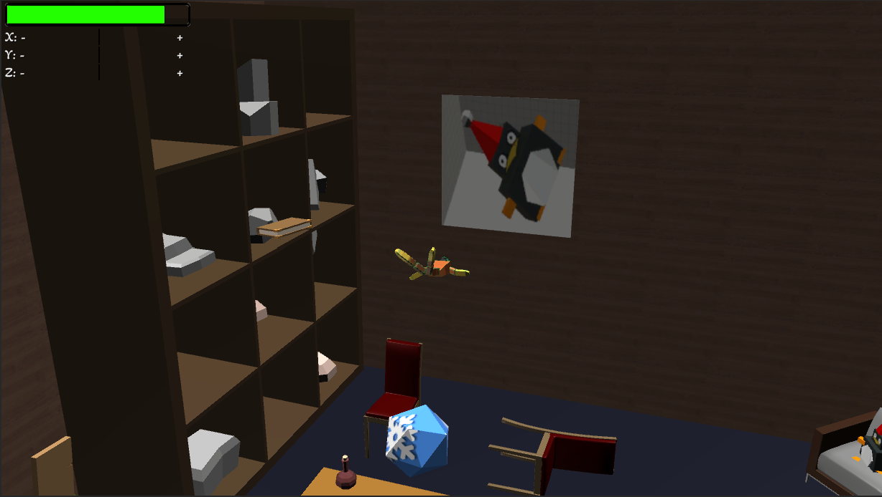
Camera Control

Slide 13
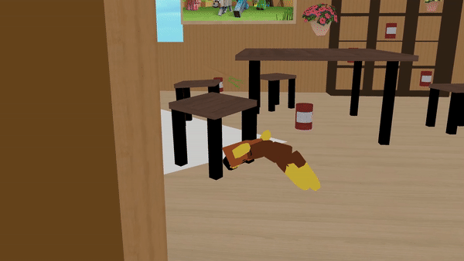
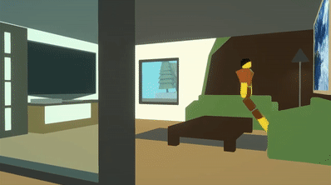
Damage System

Slide 14
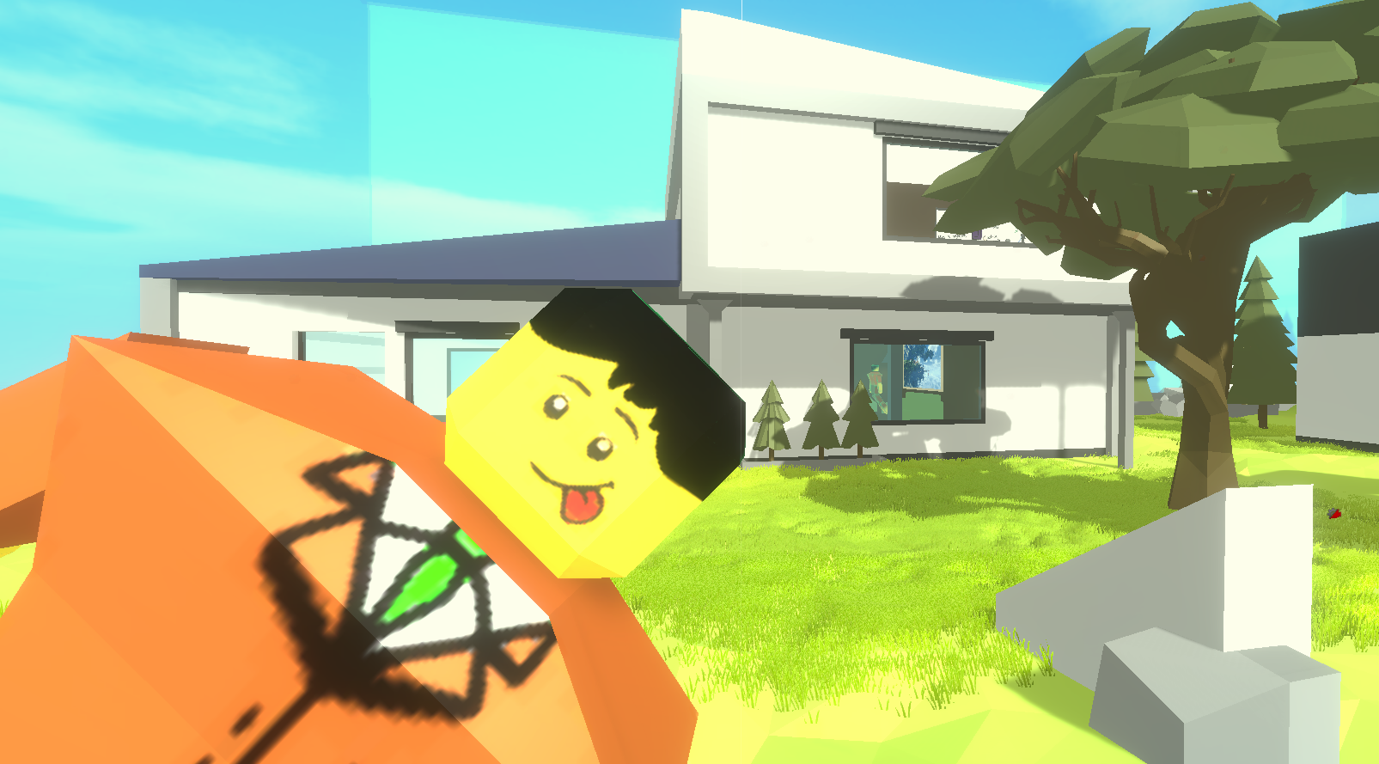
Gameplay

Slide 15
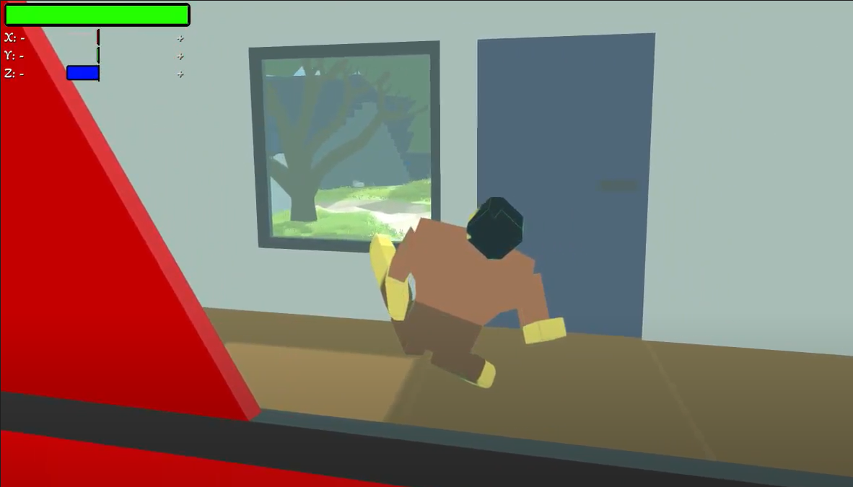

Slide 16
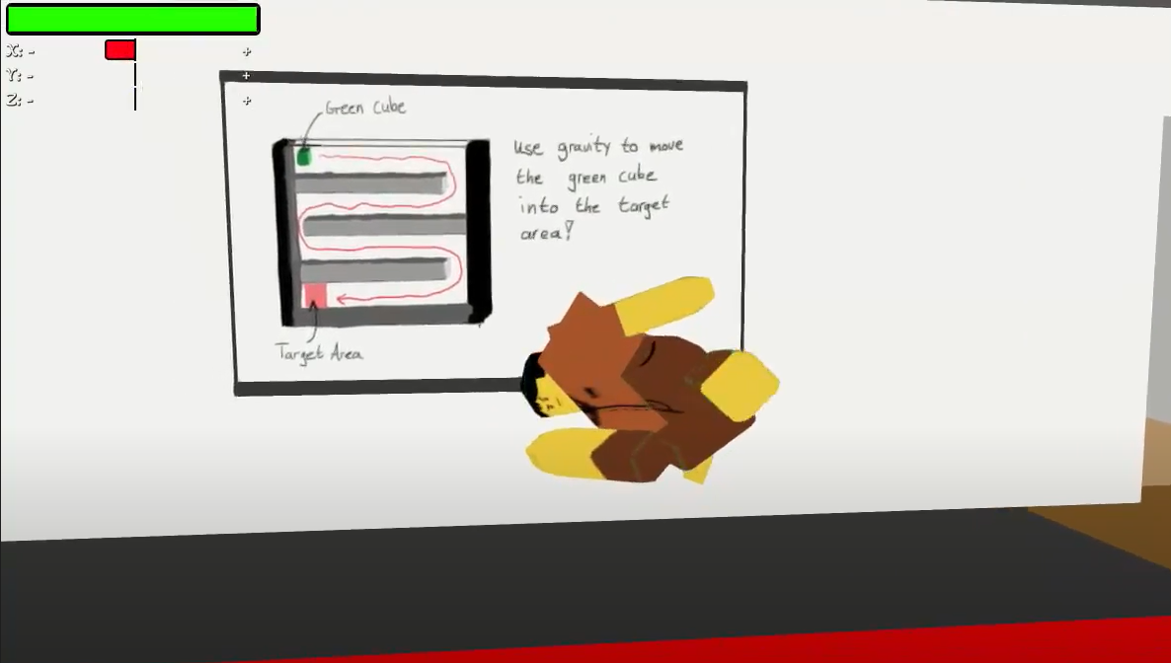

Slide 17
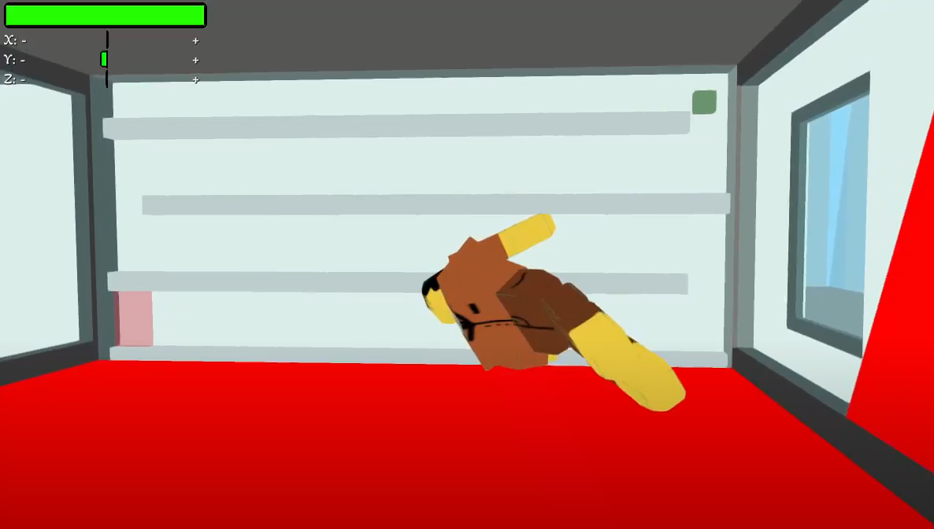

Slide 18
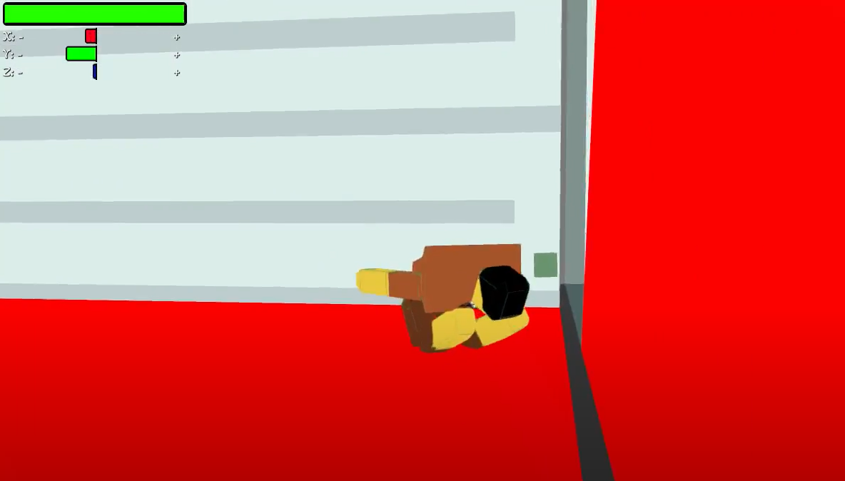

Slide 19
